Slide 1




DIGITAL LITERACY
SKILLS
BASIC USERS

Slide 2
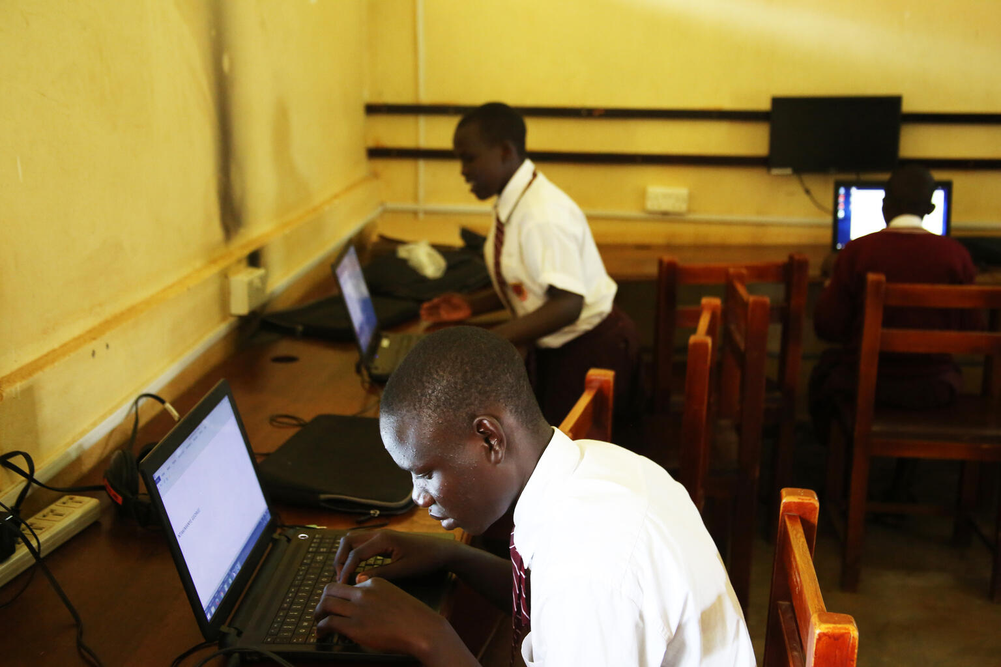
Module 6
Problem solving

Slide 3

4
Unit 4: Identifying digital competence gaps

Slide 4

The digital skills gap
Digital technologies are used in most business and industry sectors.
The demand for information and communications technology specialists is growing fast.
In the future, 9 out of 10 jobs will require digital skills.

Slide 5

Update digital skills
Invest in education
Hit subscribe

Slide 6
Skills to practise
Update your digital skills
Make a list of the programs you use on a laptop or the apps that you use while using a tablet.
Open your internet browser and type keywords that link the program or app to skills, e.g., ‘MS Word basic skills’.
Choose a video or website that demonstrates a skill that you would like to learn.

Slide 7
All back covers should include
contact information of the section
producing the work.
© United Nations Children’s Fund (UNICEF) [month and year of publication]

